Slide 1


Slide 2

About Python
What is the first thing that comes to your mind when you hear the word “Python”? Is it the violent snake or an interesting programming language?
Though both these terms sound similar, they end up having contrasting effects!!
While Python(snake) is the dangerous hostile creature, Python(programming language) on the other hand, is the friendlier one. So let us know more about the friendlier one.

Slide 3
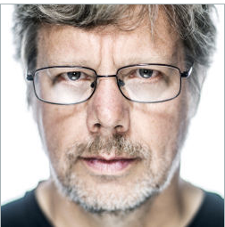
Author of Python
Created in 1989 by Guido van Rossum
A Dutch programmer, popularly known as the author of Python programming language.
Created as a scripting language for administrative tasks
Based on All Basic Code (ABC) and Modula-3
He has worked for Google and Dropbox!
Released publicly in 1991
Growing community of Python developers
Evolved into well-supported programming language.

Slide 4

Python Name Origin
There’s an interesting story about it. While implementing Python, Van Rossum was also reading the published scripts from “Monty Python’s Flying Circus”, a BBC comedy series from the 1970s. Since he wanted a short, unique and slightly mysterious name for his invention, he got inspired by the series and named it Python!

Slide 5
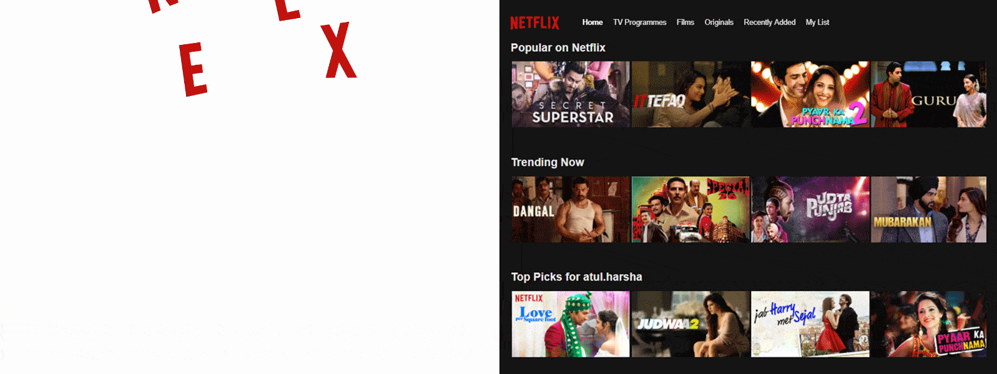
Some Real World Applications
Over 75% of what you watch is recommended by Netflix.

Slide 6
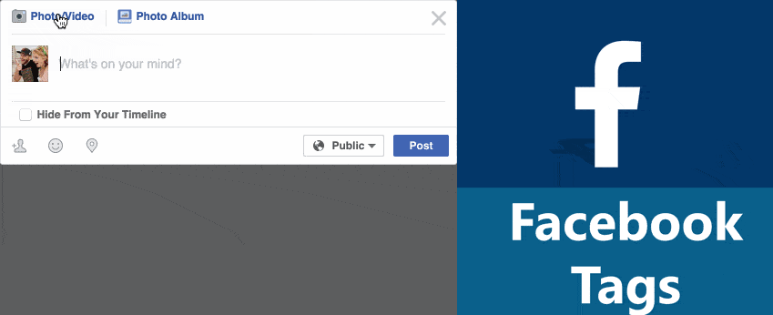
Facebook is using Machine Learning (using python) to tag in posts and images.

Slide 7
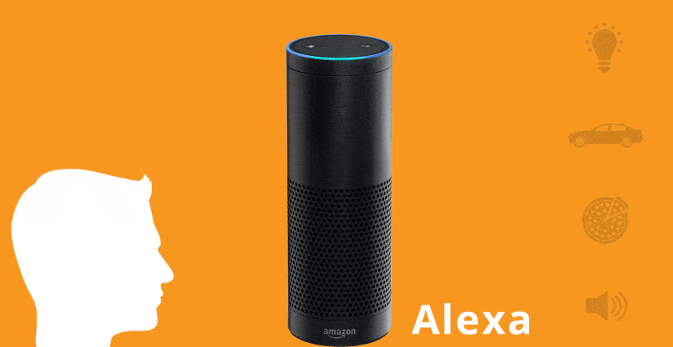
Alexa is Amazon’s Virtual Personal Assistance used for speech recognition, weather detection etc.

Slide 8
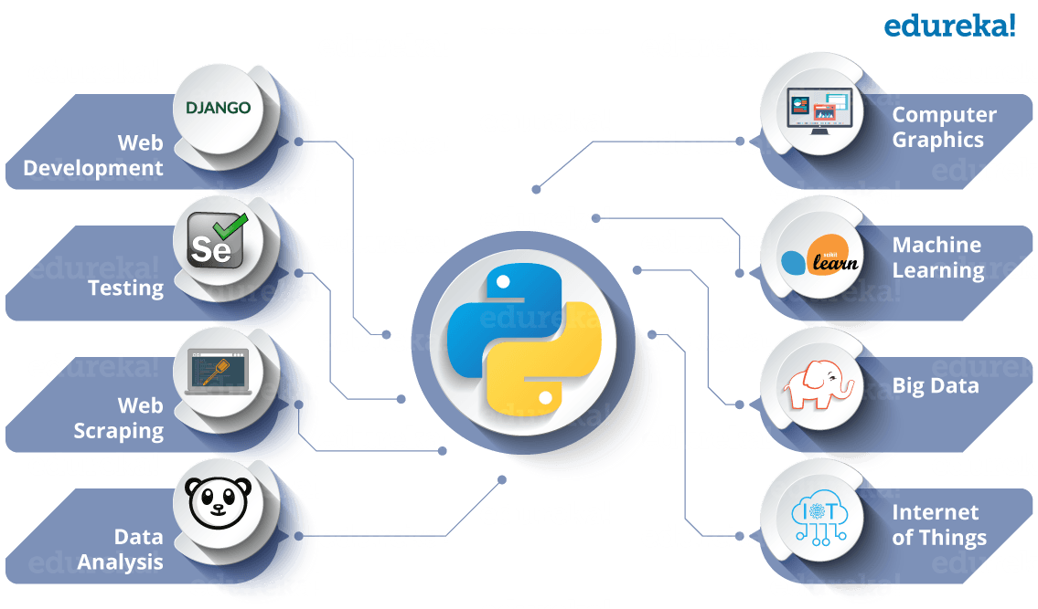
All the above technologies make use of Python as an essential core of their functionalities. So to sum up, Python is an ocean of opportunities!!

Slide 9
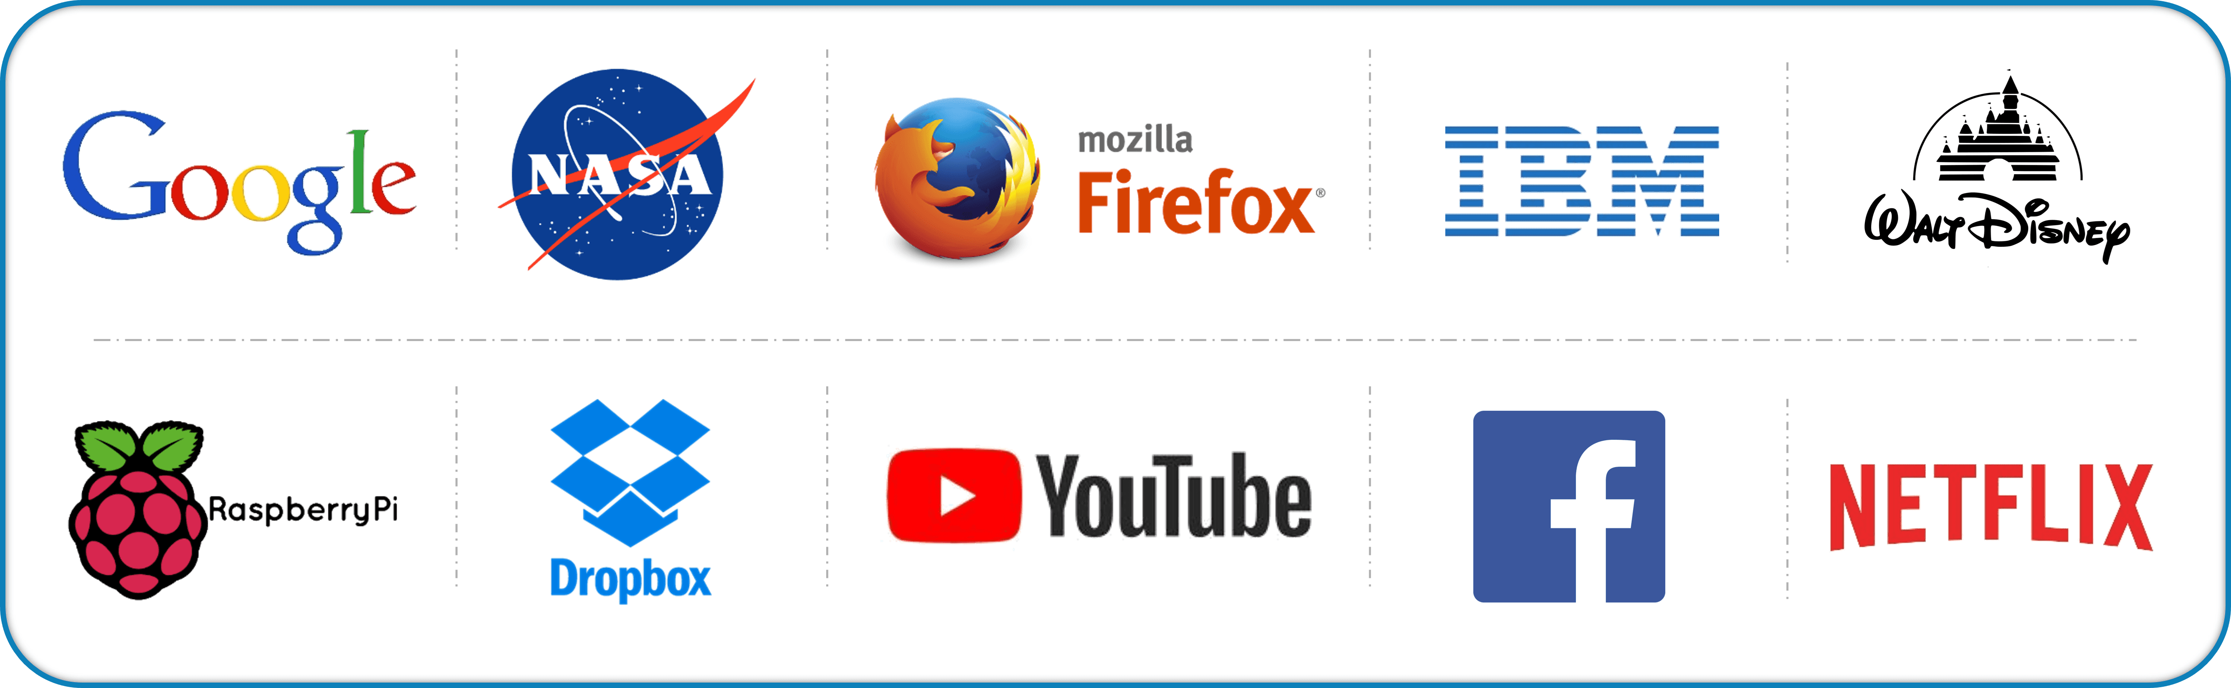
Python has grown to become a popular programming language. Let me introduce you to the BiG players:

Slide 10

Python Versions
Implementation started - December, 1989
Internal releases at Centrum Wiskunde & Informatica - 1990
Python 0.9.0 - February 20, 1991
Python 1.0 - January 1994
Python 2.0 - October 16, 2000
Python 3.0 - December 3, 2008

Slide 11
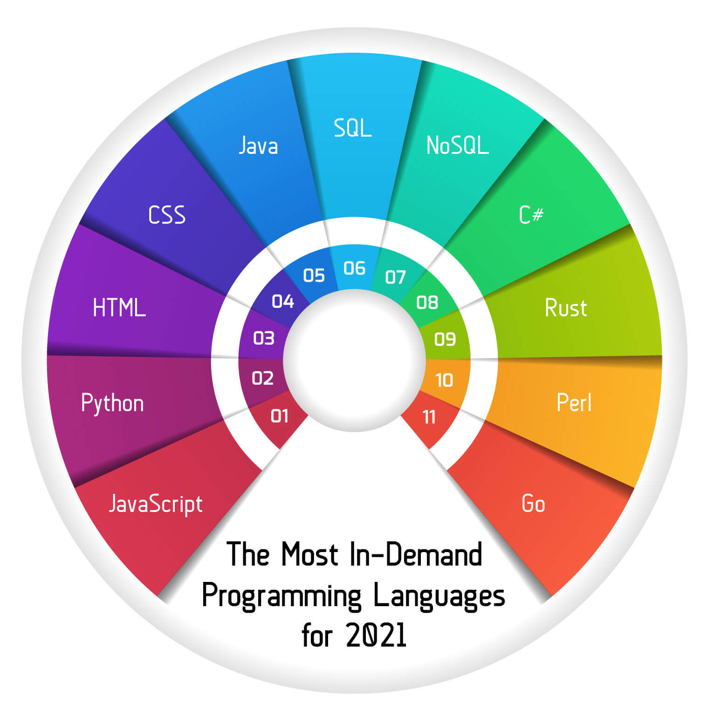
Python Trend
So, for those of you familiar with Java or C++, Python will break the mold you have built for a typical programming language.
It’s really a great language for beginners, all the way up to seasoned professionals!

Slide 12
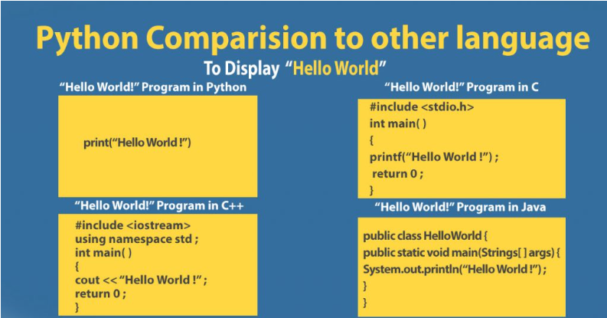

Slide 13
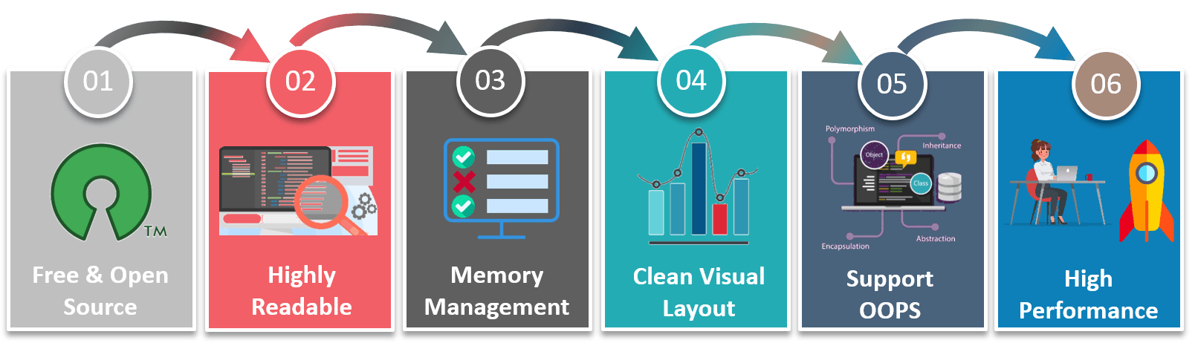
Features of Python
Python is not that complex! It is a high-level dynamic programming language and is quite easy to learn.
Python code has a very ‘natural’ style to it,
which makes it easy to read and understand.

Slide 14

Advantages of Python
The Python language has diversified application in the software development companies such as in gaming, web frameworks and applications, language development, prototyping, graphic design applications, etc.
Extensive Support Libraries
It provides large standard libraries that include the areas like string operations, Internet, web service tools, operating system interfaces and protocols.
Integration Feature
Python integrates the Enterprise Application Integration that makes it easy to develop Web services by invoking COM or COBRA components. It has powerful control capabilities as it calls directly through C, C++ or Java via Python.

Slide 15
Advantages of Python
Improved Programmer’s Productivity
The language has extensive support libraries and clean object-oriented designs that increase two to ten fold of programmer’s productivity while using the languages like Java, VB, Perl, C, C++ and C#.
Productivity
With its strong process integration features, unit testing framework and enhanced control capabilities contribute towards the increased speed for most applications and productivity of applications. It is a great option for building scalable multi-protocol network applications.

Slide 16

Disadvantages of Python
Weak in Mobile Computing
Python has made its presence on many desktop and server platforms, but it is seen as a weak language for mobile computing. This is the reason very few mobile applications are built in it like Carbonnelle.
Gets Slow in Speed
Python executes with the help of an interpreter instead of the compiler, which causes it to slow down because compilation and execution help it to work normally. On the other hand, it can be seen that it is fast for many web applications too.

Slide 17
Disadvantages of Python
Run-time Errors
The Python language is dynamically typed so it has many design restrictions that are reported by some Python developers. It is even seen that it requires more testing time, and the errors show up when the applications are finally run.
Underdeveloped Database Access Layers
As compared to the popular technologies like JDBC and ODBC, the Python’s database access layer is found to be bit underdeveloped and primitive.

Slide 18

Future Technologies Counting On Python

Slide 19
Artificial Intelligence (AI)
Python programming language is undoubtedly dominating the other languages when future technologies like Artificial Intelligence(AI) comes into the play.
It is only the Artificial Intelligence that has made it possible to develop speech recognition system, autonomous cars, interpreting data like images, videos etc.
We have shown below some of the python libraries and tools used in various Artificial Intelligence branches.
Machine Learning- PyML, PyBrain, scikit-learn, MDP Toolkit, GraphLab Create, MIPy etc.
General AI- pyDatalog, AIMA, EasyAI, SimpleAI etc.
Neural Networks- PyAnn, pyrenn, ffnet, neurolab etc.
Natural Language & Text Processing- Quepy, NLTK, gensim

Slide 20
Future Technologies Counting On Python
Big Data
The future scope of python programming language can also be predicted by the way it has helped big data technology to grow. Python has been successfully contributing in analysing the large amount of data sets across computer clusters through its high performance toolkits and libraries.
Networking
Networking is the another field in which python has a brighter scope in the future. Python programming language is used to read, write and configure routers and switches and perform other networking automation tasks in a cost effective and secure manner.

Slide 21
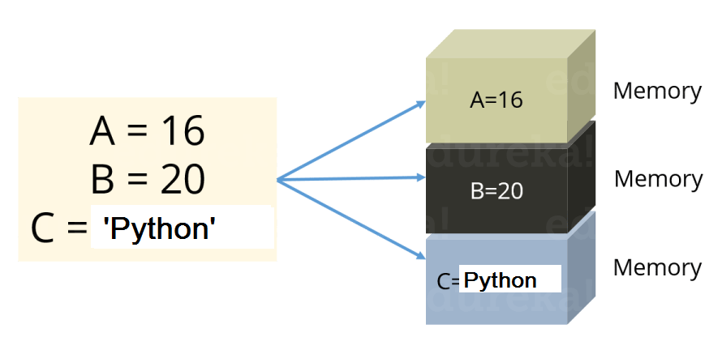
Variables in Python: Variables are nothing but reserved memory locations to store values. This means that when you create a variable you reserve some space in memory. In Python you don’t need to declare variables before using it, unlike other languages like Java, C etc. Naming Rules : (underscore or letter) + (any number of letters, digits, or underscores) Variable names must start with an underscore or letter. They can be followed by any number of letters, digits, or underscores.
Sample :
S = 10
print(S)

Slide 22
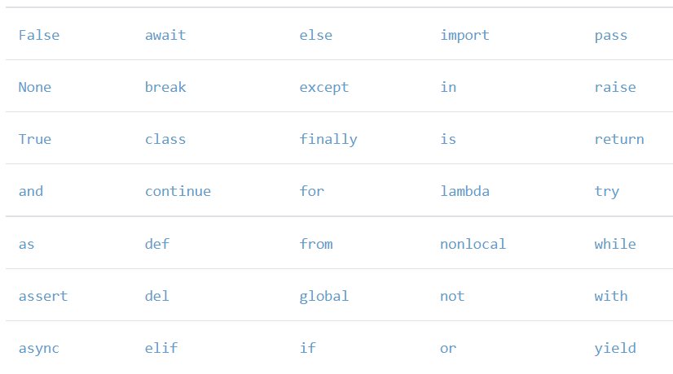
Python 3.X reserved words
The following lists the Python 3.X reserved words.

Slide 23
By Category
Value Keywords: True, False, None.
Operator Keywords: and, or, not, in, is.
Control Flow Keywords: if, elif, else.
Iteration Keywords: for, while, break, continue, else.
Structure Keywords: def, class, with, as, pass, lambda.
Returning Keywords: return, yield.
Import Keywords: import, from, as.

Slide 24
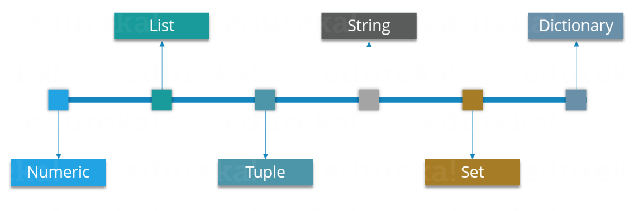
Data Types in Python:

Slide 25
Numeric:
Just as expected Numeric data types store numeric values. They are immutable data types, this means that you cannot change it’s value. Python supports three different Numeric data types:
Integer type: It holds all the integer values i.e. all the positive and negative whole numbers, example – 10.
Float type: It holds the real numbers and are represented by decimal and sometimes even scientific notations with E or e indicating the power of 10 (2.5e2 = 2.5 x 102 = 250), example – 10.24.
Complex type: These are of the form a + bj, where a and b are floats and J represents the square root of -1 (which is an imaginary number), example – 10+6j.

Slide 26
List:
You can consider the Lists as Arrays in C, but in List you can store elements of different types, but in Array all the elements should of the same type.
List is the most versatile datatype available in Python which can be written as a list of comma-separated values (items) between square brackets.
Example
Subjects = ['Physics', 'Chemistry', 'Maths', 2] print(Subjects)

Slide 27
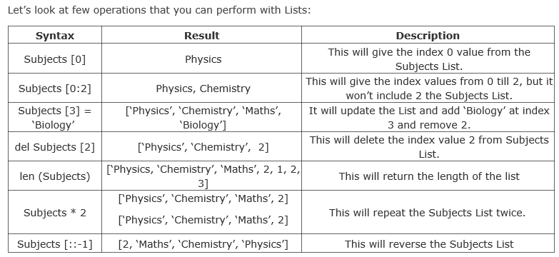

Slide 28
Tuples:
A Tuple is a sequence of immutable Python objects.
Tuples are sequences, just like Lists. The differences between tuples and lists are:
Tuples cannot be changed unlike lists
Tuples use parentheses, whereas lists use square brackets.
Consider the example below:
Subjects = ('Physics', 'Chemistry', 'Maths', 2)

Slide 29
Strings:
Strings are amongst the most popular data types in Python.
We can create them simply by enclosing characters in quotes.
Python String is immutable sequence . The immutable means that you cannot change a string in place
Python treats single and double quotes in exactly the same fashion.
Consider the example below:
S = "Welcome To Python!"
D = ‘Python!'

Slide 30
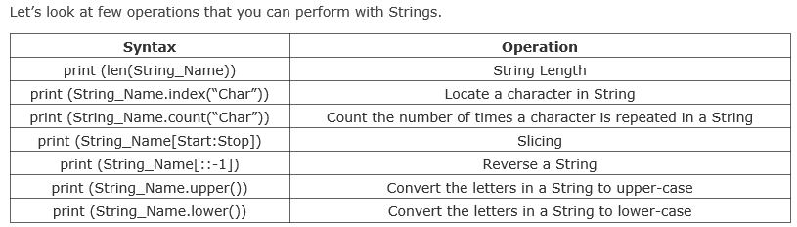

Slide 31
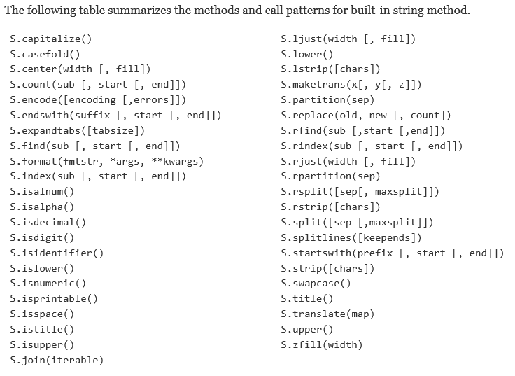

Slide 32
Now you must be thinking why Tuples when we have Lists?
So the simple answer would be, Tuples are faster than Lists. If you’re defining a constant set of values which you just want to iterate, then use Tuple instead of a List.
Guys, all Tuple operations are similar to Lists, but you cannot update, delete or add an element to a Tuple.

Slide 33
Set:
A Set is an unordered collection of items. Every element is unique.
A Set is created by placing all the items (elements) inside curly braces {}.
separated by comma.
Consider the example below:
Set_1 = {1, 2, 3}
In Sets, every element has to be unique.
Try printing the below code:
Set_2 = {1, 2, 3, 3}
Here 3 is repeated twice, but it will print it only once.

Slide 34
Let’s look at some Set operations:
Union:
Union of A and B is a set of all the elements from both sets. Union is performed using | operator

Slide 35
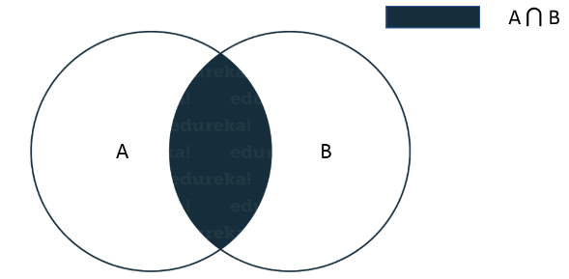
Intersection: Intersection of A and B is a set of elements that are common in both sets. Intersection is performed using & operator

Slide 36
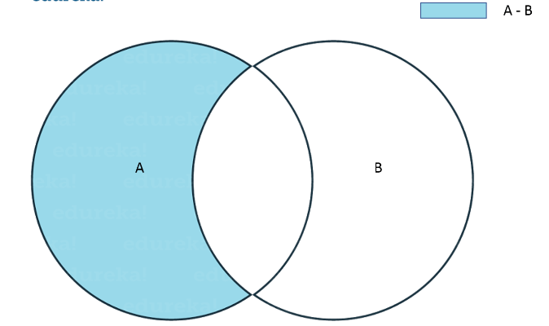
Difference:
Difference of A and B (A – B) is a set of elements that are only in A but not in B. Similarly, B – A is a set of element in B but not in A.

Slide 37
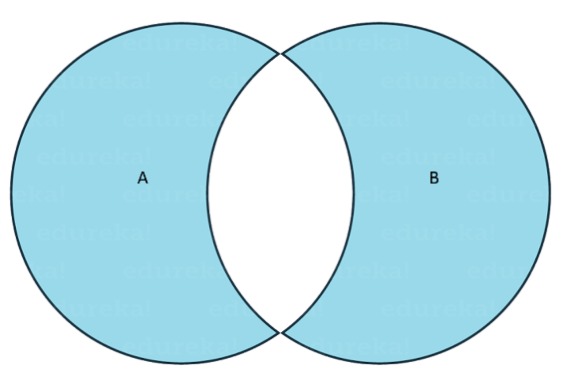
Symmetric Difference:
Symmetric Difference of A and B is a set of elements in both A and B except those that are common in both. Symmetric difference is performed using ^ operator.

Slide 38
Dictionary:
Dictionaries contains these ‘Key Value’ pairs enclosed within curly braces and Keys and values are separated with ‘:’.
Consider the below example:
Dict = {'Name' : 'Saurabh', 'Age' : 23}

Slide 39
Tuples
Tuples construct groups of objects.
They work exactly like lists, except that tuples are immutable.
Tuples are usually written as a series of items in parentheses.

Slide 40
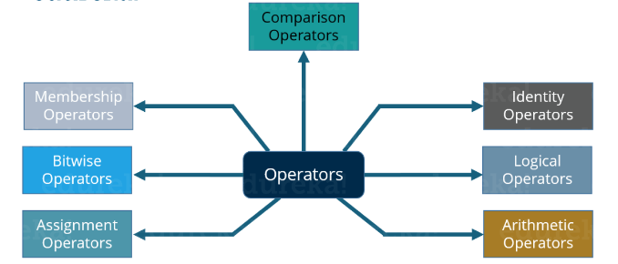
Operators in Python:
Operators are the constructs which can manipulate the values of the operands.
Consider the expression 2 + 3 = 5, here 2 and 3 are operands and + is called operator.
Python supports the following types of Operators:

Slide 41
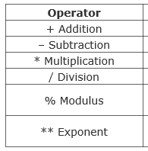
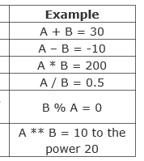
Arithmetic Operators:

Slide 42
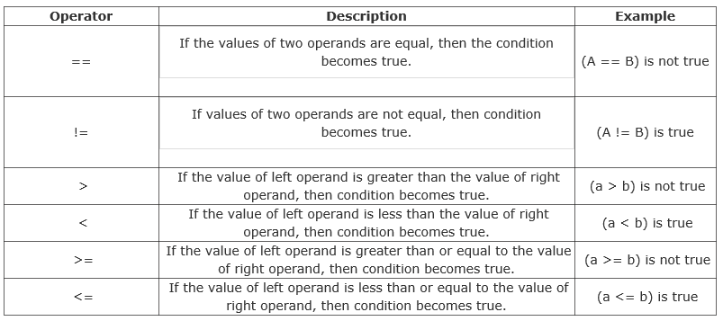
Comparison Operators:
These Operators compare the values on either sides of them and decide the relation among them.
Assume A = 10 and B = 20.

Slide 43
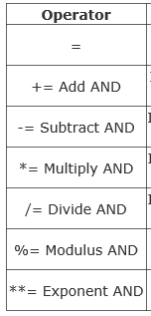
Assignment Operators:
An Assignment Operator is the operator used to assign a new value to a variable.

Slide 44
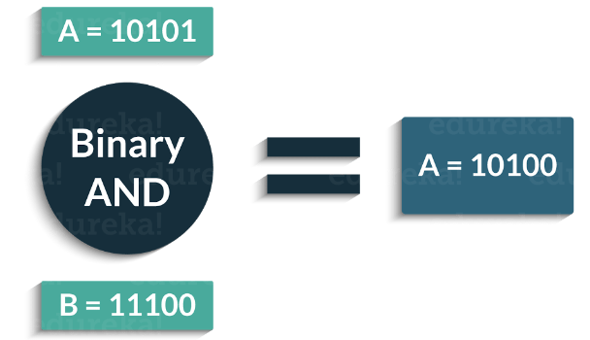
Bitwise Operators:
These operations directly manipulate bits. In all computers, numbers are represented with bits, a series of zeros and ones.
In fact, pretty much everything in a computer is represented by bits.
Consider the example shown below:

Slide 45
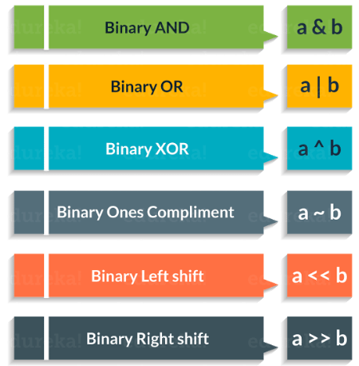
Following are the Bitwise Operators supported by Python:

Slide 46
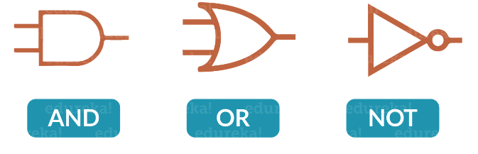
Logical Operators:
True if both the operands are true
True if either of the operands are true
True if operand is false (complements the operand)

Slide 47
Membership Operators:
These Operators are used to test whether a value or a variable is found in a sequence (Lists, Tuples, Sets, Strings, Dictionaries) or not.
The following are the Membership Operators:

Slide 48
Identity Operators:
These Operators are used to check if two values (or variables) are located on the same part of the memory. Two variables that are equal does not imply that they are identical.
Following are the Identity Operators in Python:

Slide 49
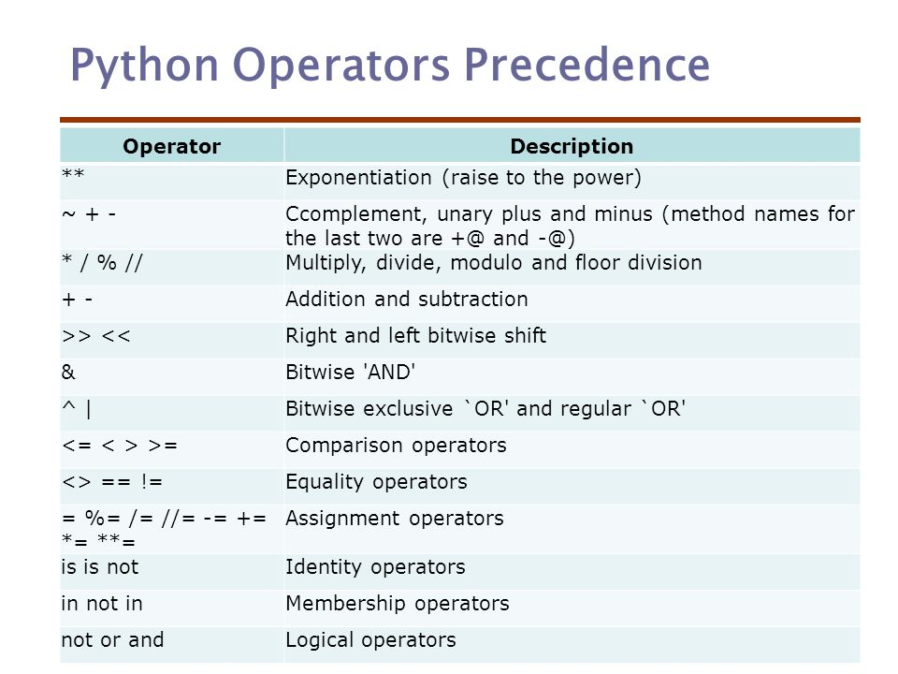

Slide 50
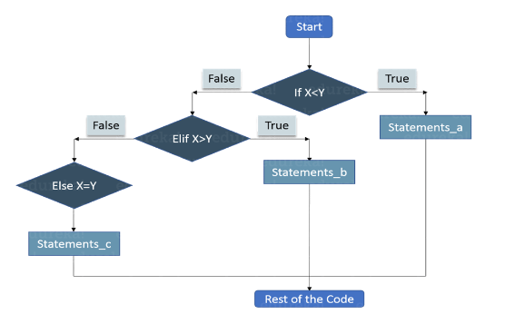
Conditional Statements:
Conditional statements are used to execute a statement or a group of statements when some condition is true. There are namely three conditional statements – If , Else, Elif.

Slide 51
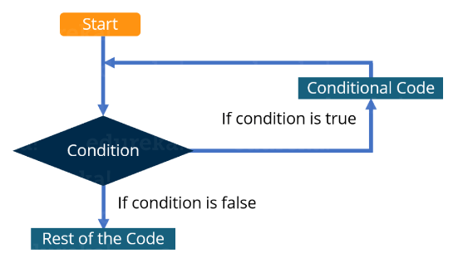
Loops:
In general, statements are executed sequentially. The first statement in a function is executed first, followed by the second, and so on
There may be a situation when you need to execute a block of code several number of times
A loop statement allows us to execute a statement or group of statements multiple times. The following diagram illustrates a loop statement:

Slide 52
Loops in Python:
In Python, there are three loops:
While
For
Nested
While Loop: Here, first the condition is checked and if it’s true, control will move inside the loop and execute the statements inside the loop until the condition becomes false.
For Loop: Like the While loop, the For loop also allows a code block to be repeated certain number of times. The difference is, in For loop we know the amount of iterations required unlike While loop, where iterations depends on the condition. Syntax
for variable in Sequence:
statements
Nested Loops: It basically means a loop inside a loop. It can be a For loop inside a While loop and vice-versa. Even a For loop can be inside a For loop or a While loop inside a While loop.

Slide 53
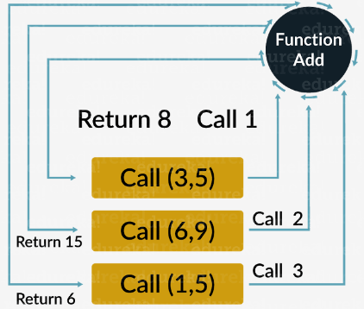
Functions:
Functions are a convenient way to divide your code into useful blocks, allowing us to order our code, make it more readable, reuse it and save some time.

Slide 54
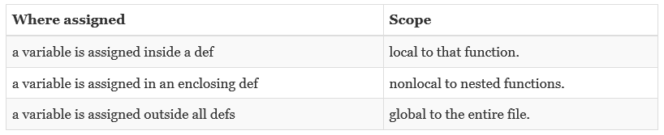
Variable Scope
Variables may be assigned in three different places, corresponding to three different scopes:

Slide 55
Conclusion
Since then, Python has emerged as one of the top four or five most widely used programming languages in the world. As it has grown in popularity, its focus on code quality and readability, and their related impact on developer productivity, seems to have become the more dominant factor behind Python's success.

Slide 56


Slide 57
Interesting Facts About Python
https://www.geeksforgeeks.org/py-facts-10-interesting-facts-about-python/
https://www.edureka.co/blog/python-interesting-facts-you-need-to-know/
https://www.tutorialspoint.com/python3/python3_tutorial.pdf
https://www.edureka.co/blog/python-tutorial/
Real World examples using Python
https://www.youtube.com/watch?v=XP8SV42YcDo

